Slide 1


Integration & Performance 2
Feb 2024
Presentation by:
Khai Mubarak, Khairulamirin, Jolyene & Khalifahtularif

Slide 2


Contexts
Introduction
Building an application CI/CD pipeline steps
Purpose of a CI/CD Pipeline
Install ansible for configuration management to install docker
Install a single Kubernetes cluster
Provision a Jenkins master pod in the Kubernetes cluster
Configure Jenkins and install all necessary plugins
Create a Jenkins agent image with python support
Use git to manage the python script changes
Create a python script with menu selection for system status monitoring
Create a multistage Jenkins pipeline to integrate, test and deploy the python script
Commands/Results
Summary
Q&A Session

Slide 3
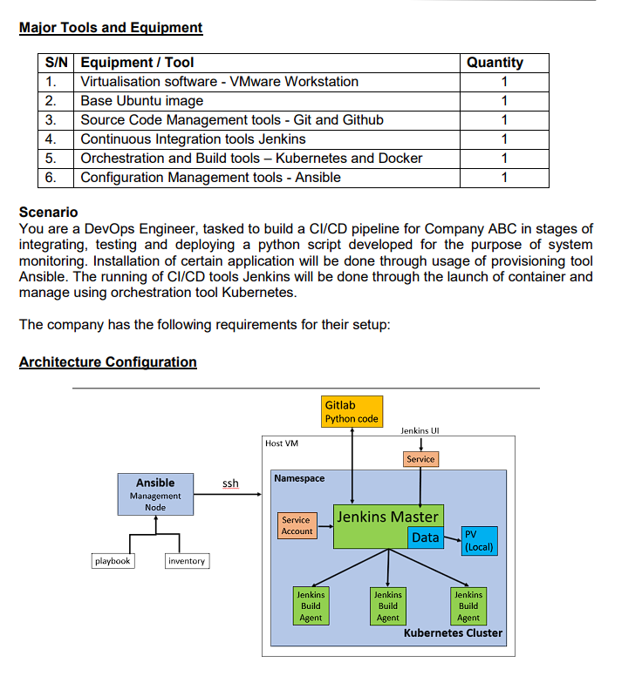
Introduction
To test the skills in collaborating to build an application CI/CD pipeline
A CI/CD (Continuous Integration/Continuous Deployment) pipeline is a set of automated processes that facilitate the development, testing, and deployment of software applications. The primary goals of CI/CD are to improve the efficiency, reliability, and speed of software delivery.

Slide 4

Purpose of a CI/CD Pipeline
The purpose of a CI/CD pipeline is to automate and streamline the processes involved in software development, testing, and deployment. This approach offers several benefits to development teams and organizations:
Faster Release Cycles
Reduced Manual Errors
Consistency Across Environments
Early Detection of Issues
Efficient Collaboration
Automated Testing
Improved Code Quality
Faster Time-to-Market
Feedback Loop
Scalability

Slide 5

Building an application CI/CD pipeline steps
Install ansible for configuration management to install docker
Install a single Kubernetes cluster
Provision a Jenkins master pod in the Kubernetes cluster
Configure Jenkins and install all necessary plugins
Create a Jenkins agent image with python support
Use git to manage the python script changes
Create a python script with menu selection for system status monitoring
Create a multistage Jenkins pipeline to integrate, test and deploy the python script

Slide 6
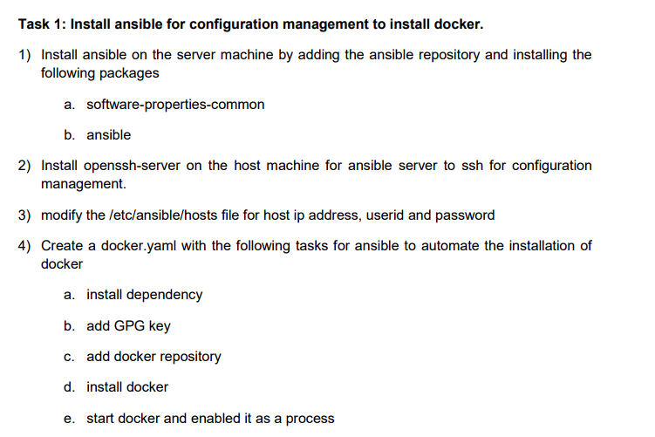
Task 1: Install ansible for configuration management to install docker.

Slide 7
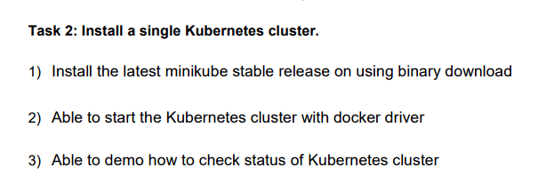
Task 2: Install a single Kubernetes cluster.

Slide 8
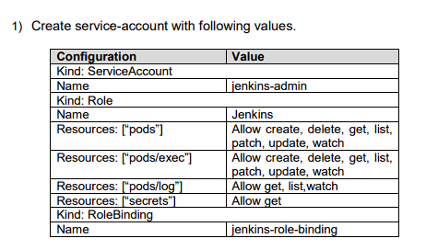
Task 3: Provision a Jenkins master pod in the Kubernetes cluster.

Slide 9
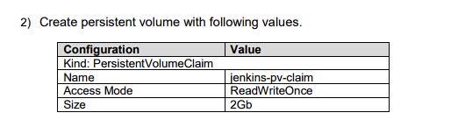
Task 3: Provision a Jenkins master pod in the Kubernetes cluster.

Slide 10
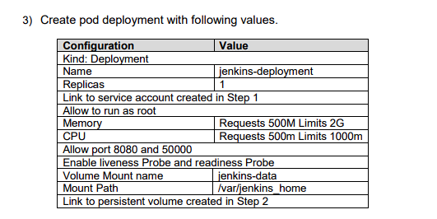
Task 3: Provision a Jenkins master pod in the Kubernetes cluster.

Slide 11
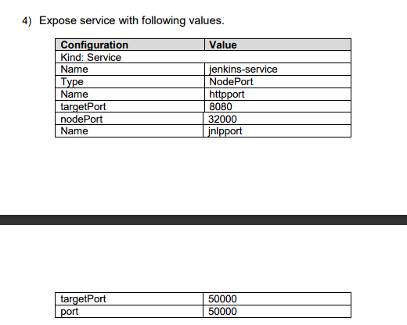
Task 3: Provision a Jenkins master pod in the Kubernetes cluster.

Slide 12
Task 3: Provision a Jenkins master pod in the Kubernetes cluster.
Able to demo how to check status of all the resources created.

Slide 13
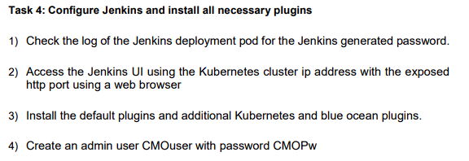
Task 4: Configure Jenkins and install all necessary plugins

Slide 14
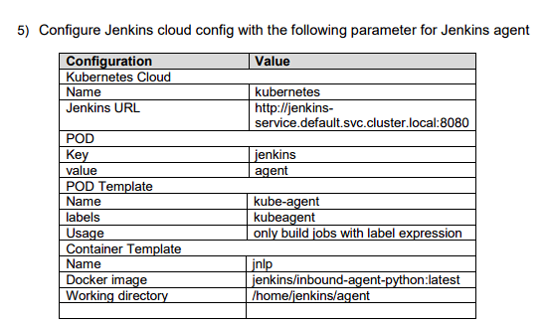
Task 4: Configure Jenkins and install all necessary plugins

Slide 15
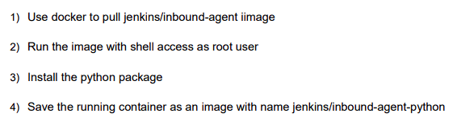
Task 5: Create a Jenkins agent image with python support
1 docker pull jenkins/inbound-agent
2 docker images
3 docker ps -a
4 docker run -u root -i -t jenkins/inbound-agent bash
5 exit
6 sudo docker ps
7 sudo docker ps | grep jenkins
8 sudo docker exec -it -u root ed02017ee4d2 /bin/bash
9 exit
10 history

Slide 16
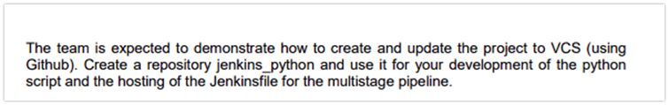
Task 6: Use git to manage the python script changes

Slide 17
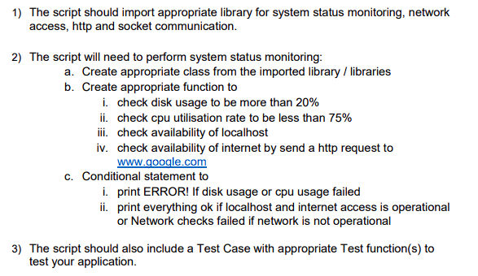
Task 7: Create a python script with menu selection for system status monitoring

Slide 18
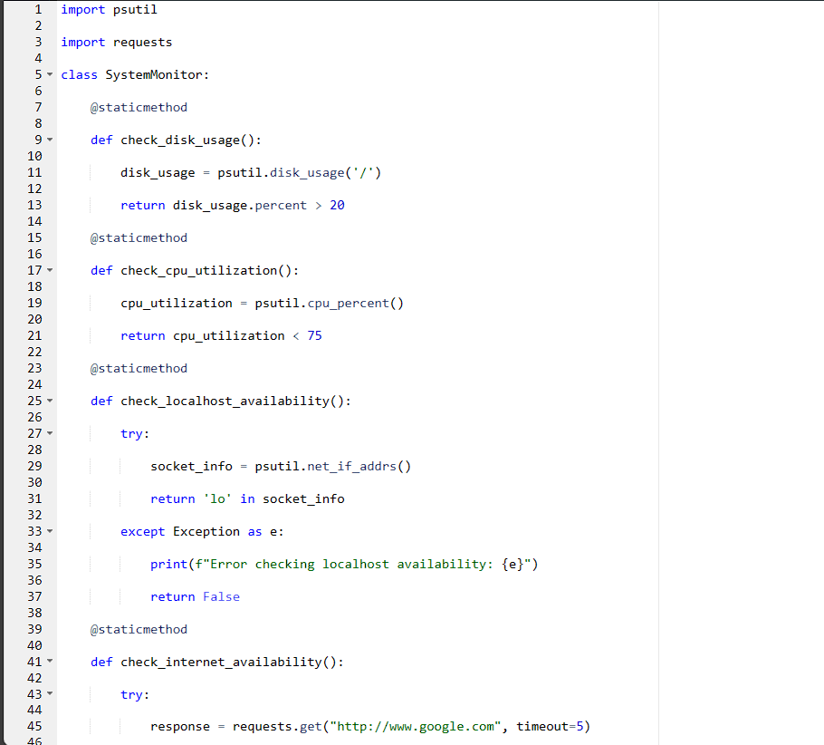
Task 7: Create a python script with menu selection for system status monitoring

Slide 19
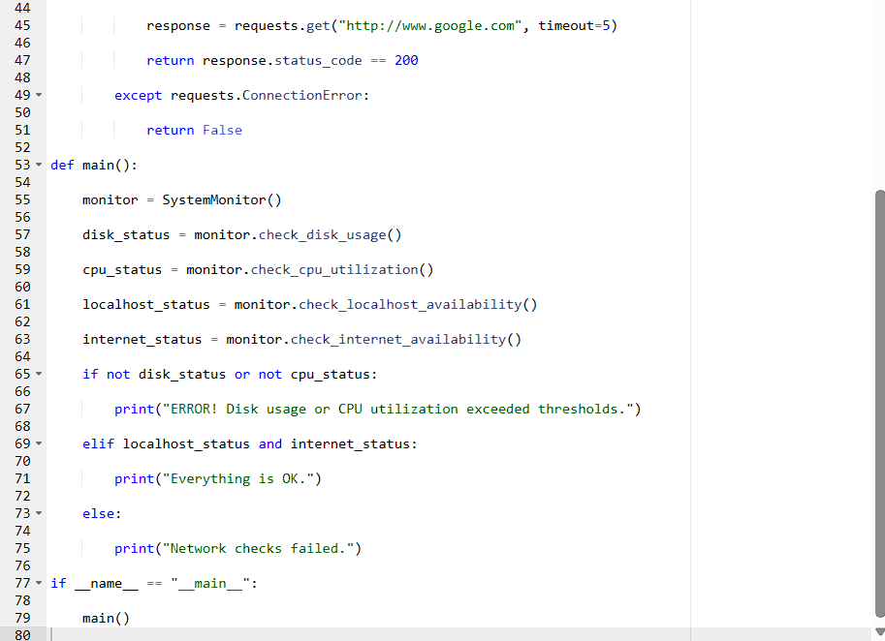
Task 7: Create a python script with menu selection for system status monitoring

Slide 20

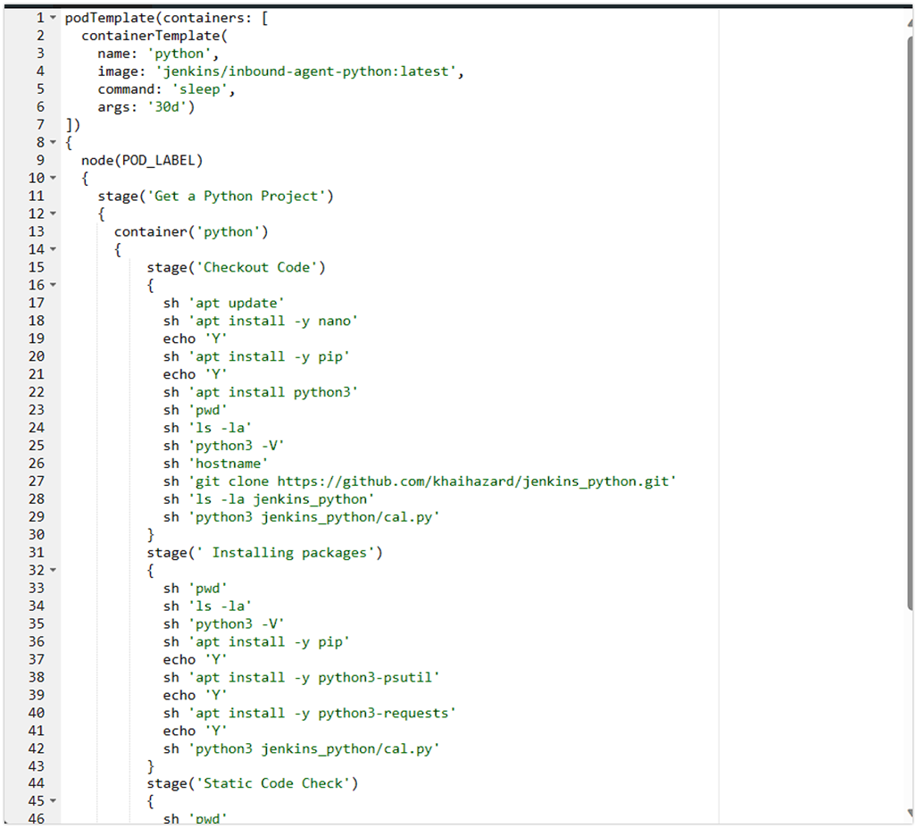
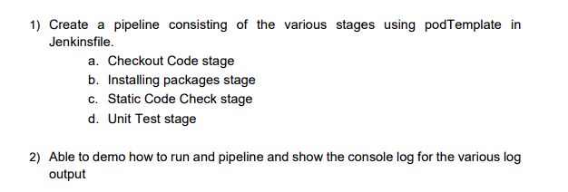
Task 8: Create a multistage Jenkins pipeline to integrate, test and deploy the python script

Slide 21
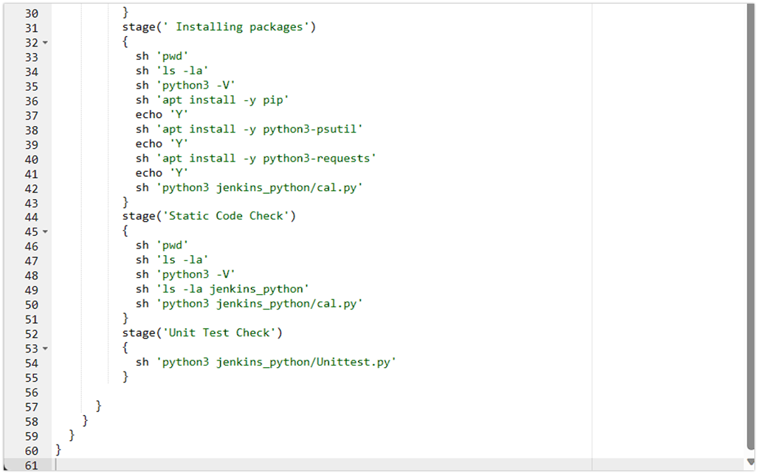
Task 8: Create a multistage Jenkins pipeline to integrate, test and deploy the python script

Slide 22
Commands/Results
36 minikube kubectl -- get po -A
37 minikube dashboard
38 minikube config set driver docker
39 minikube start
40 minikube dashboard
41 minikube start --driver=docker
42 minikube kubectl -- get po -A
43 alias kubectl="minikube kubectl --"
44 kubectl create namespace devops-tools
45 sudo nano service-account.yaml
46 kubectl apply -f service-account.yaml
47 kubectl get sa -A kubectl
48 kubectl get sa -A
49 kubectl get serviceaccount
50 kubectl get role
51 kubectl get rolebinding
52 kubectl describe role
53 sudo nano persistentstorage.yaml
54 kubectl apply -f persistentstorage.yaml
55 kubectl get pv,pvc
56 sudo nano deployment.yaml
57 kubectl apply -f deployment.yaml
58 kubectl rollout status deployment jenkins-deployment
59 sudo nano service.yaml

Slide 23
Commands/Results
60 kubectl apply -f service.yaml
61 kubectl get services
62 minikube ip
63 kubectl describe pod
64 kubectl logs jenkins-deployment-75787d68bf-hlxk4
65 history
66 docker pull jenkins/inbound-agent
67 minikube ssh
68 python -v
69 history
70 kubectl get po -n jenkins -o wide
71 minikube ssh
72 history
73 minikube ssh
74 history

Slide 24
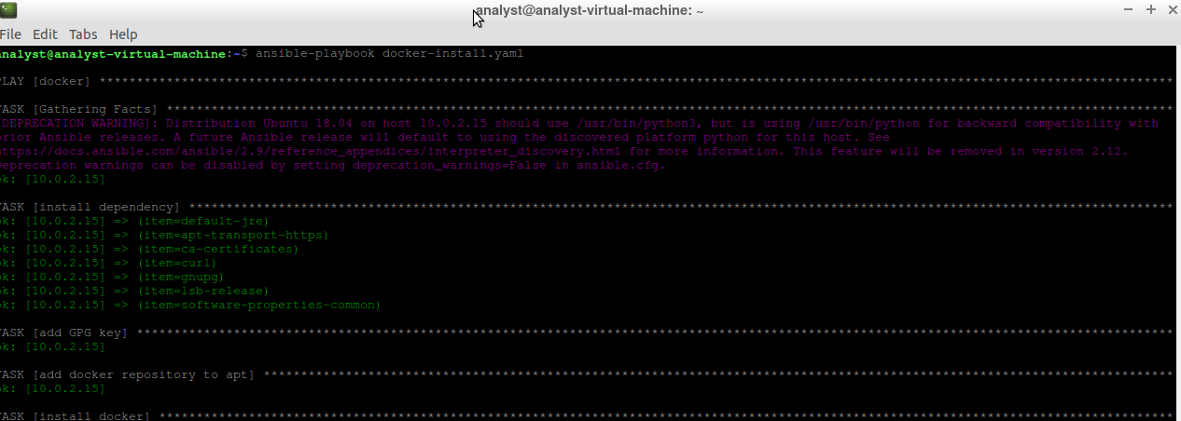
Commands/Results

Slide 25
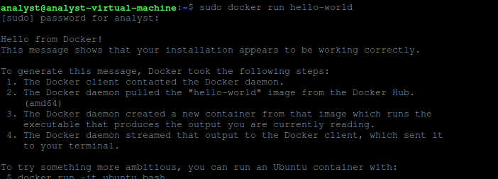
Commands/Results

Slide 26
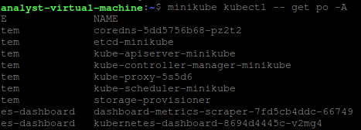
Commands/Results

Slide 27
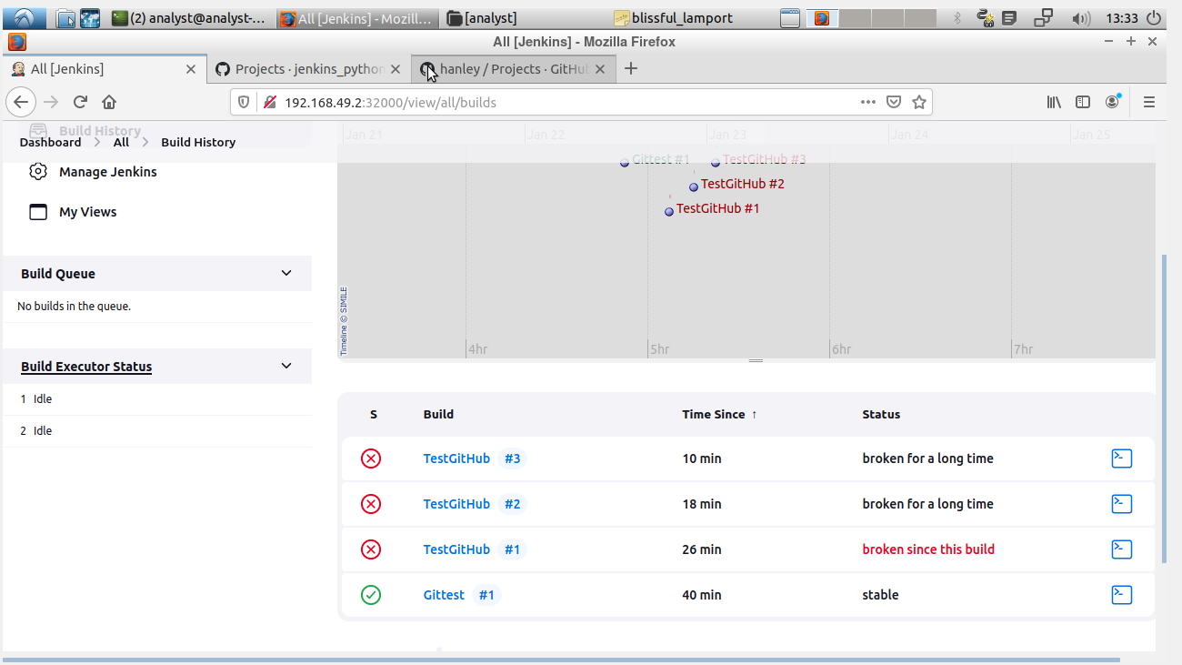
Commands/Results

Slide 28
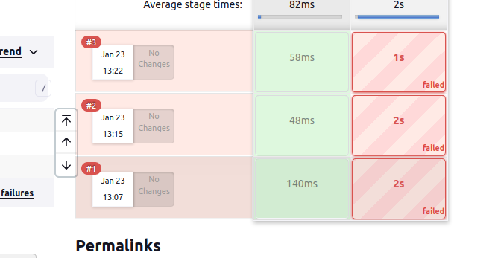
Commands/Results

Slide 29
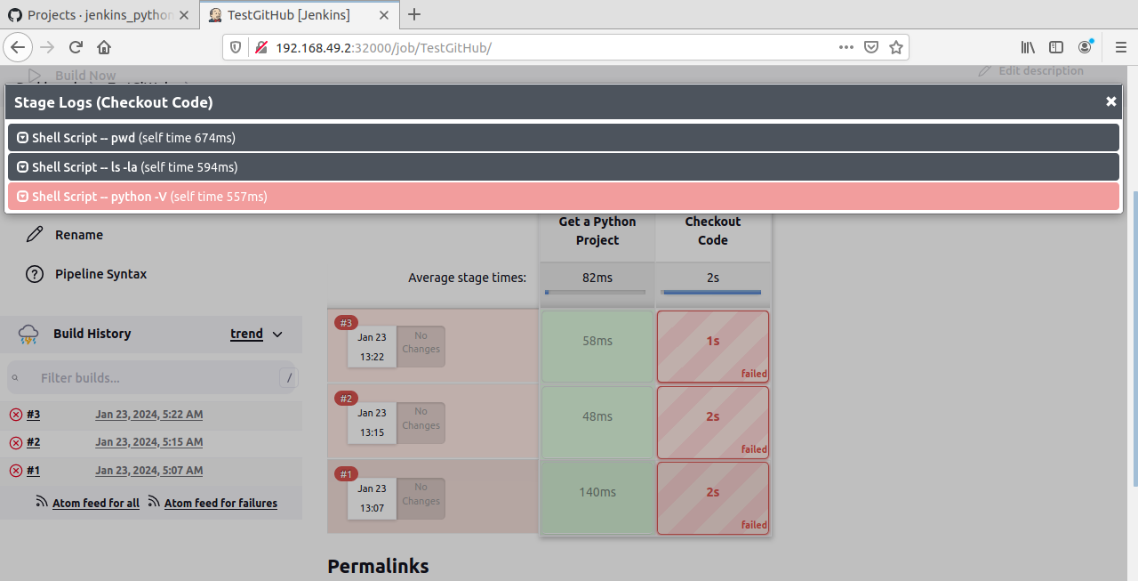
Commands/Results

Slide 30
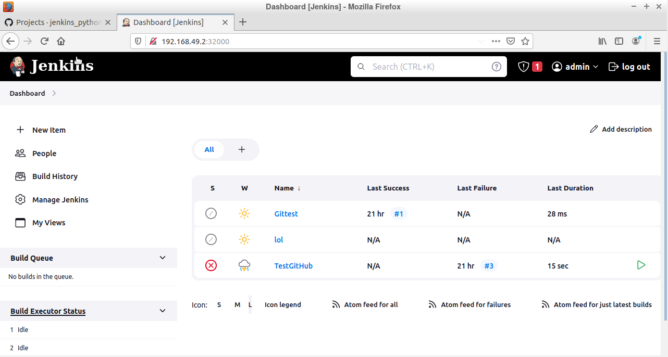
Commands/Results

Slide 31
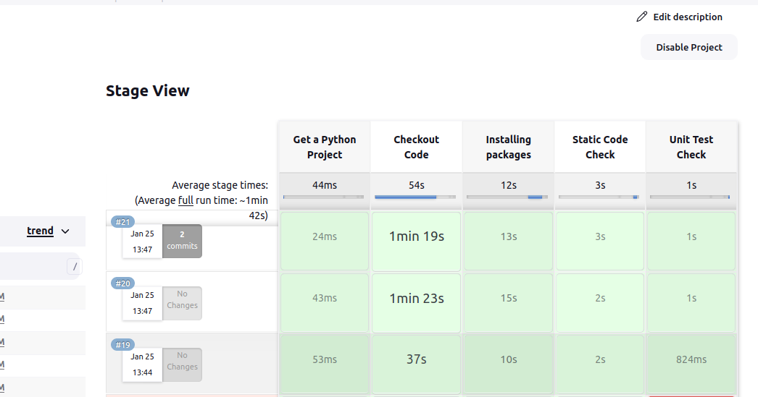
Commands/Results

Slide 32
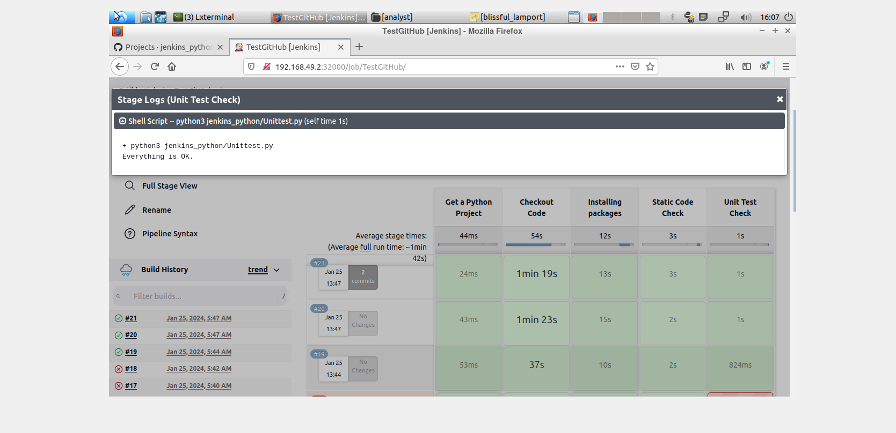
Commands/Results

Slide 33
Summary
Build a comprehensive CI/CD pipeline for Company ABC's Python system monitoring script, involving Jenkins, Ansible, Docker, and Kubernetes. Stages include version control, Jenkins CI with unit testing, Ansible provisioning, integration testing, and CD with production deployment. Jenkins is containerized and orchestrated by Kubernetes. Implement monitoring, security, and documentation for a robust, automated, and scalable pipeline. Continuous improvement through feedback loops ensures ongoing optimization.

Slide 34
Summary
Python CI/CD pipeline is not working as expected, it can be due to various reasons. Here are common challenges and troubleshooting steps:
Incorrect Pipeline Configuration:
Issue: Check the Jenkinsfile or pipeline script for syntax errors, misconfigurations, or missing stages.
Solution: Review and correct the pipeline configuration to ensure it accurately reflects the intended workflow.
Dependency Issues:
Issue: Incorrect or missing dependencies in the Python script or the build environment.
Solution: Verify that all required dependencies are specified and properly installed. Consider using virtual environments to isolate dependencies.
Versioning and Compatibility:
Issue: Mismatched Python versions or library versions between development and deployment environments.
Solution: Standardize Python versions and dependencies across environments. Use virtual environments or containerization to maintain consistency.
Network or Connectivity Issues:
Issue: Problems accessing external repositories or services for dependencies.
Solution: Ensure that the CI/CD environment has internet access and can reach necessary repositories. Check proxy settings if applicable.
Incomplete or Failed Tests:
Issue: Unit tests or integration tests are failing, preventing the pipeline from progressing.
Solution: Investigate the test failures, fix issues in the code, and ensure that tests cover relevant scenarios. Improve test reporting for better diagnostics.
Misconfigured Jenkins Agent:
Issue: Jenkins agents are misconfigured or not properly connected.
Solution: Verify that Jenkins agents are correctly configured and connected to the master. Ensure proper agent labels and availability..

Slide 35
Summary
Authentication and Permissions:
Issue: Insufficient permissions for Jenkins to access the version control system, artifact repositories, or deployment targets.
Solution: Check and update credentials in Jenkins for accessing repositories and other external systems. Verify that the necessary permissions are granted.
Artifact Management Issues:
Issue: Artifacts are not being generated or stored correctly.
Solution: Confirm that the artifact generation and storage steps are properly configured in the pipeline. Check for any errors in the artifact creation process.
Logging and Debugging:
Issue: Inadequate logging and debugging information to identify the root cause.
Solution: Enhance logging in the pipeline stages and scripts. Enable debugging options where necessary. Inspect Jenkins logs and console output for errors.
Pipeline Environment:
Issue: Pipeline is running in an environment with different characteristics than expected (e.g., different operating system, Python version).
Solution: Ensure that the pipeline environment matches the expected runtime environment. Use Docker containers or virtual machines to create consistent build environments.
External Service Outages:
Issue: External services, such as version control or artifact repositories, are experiencing outages.
Solution: Check the status of external services and wait for them to become available. Implement retry mechanisms in the pipeline for robustness.
Pipeline Optimization:
Issue: Inefficient or poorly optimized pipeline configurations.
Solution: Review the pipeline for areas of optimization. Minimize redundant steps, parallelize where possible, and optimize resource usage.

Slide 36

Q&A Session

Slide 37

Thank You

